Slide 1
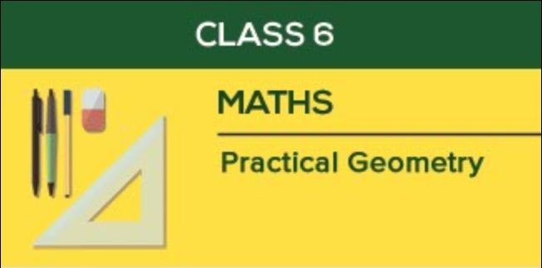
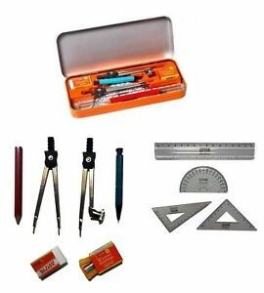

Slide 2
CONTENT
Introduction of geometry.
Introducing Tools in Geometry box
Circle and its construction
Line ,Line segment and its construction
Perpendicular
Perpendicular Bisector
Angles and its construction

Slide 3
Geometry

Slide 4
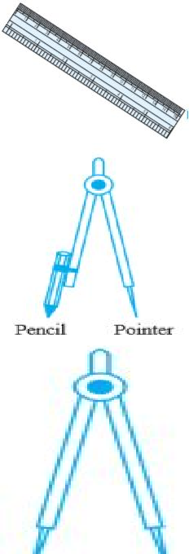
Description
Name of Figure
Shape
Use
Ruler
A ruler ideally has no marking on it. However, the ruler in your instruments box is graduated into centimetres along one edge and other inches.
To draw a line segment and to measure their lengths.
Compasses
A pair – a pointer on one end and a pencil on the other.
To mark off equal lengths but not to measure them To draw arcs and circles.
Divider
A pair of pointers
To compare lengths.

Slide 5
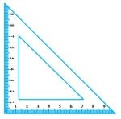
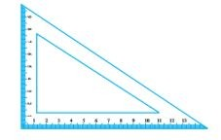
To draw perpendicular and parallel lines
Set Square
Protractor
To draw and measure angles

Slide 6
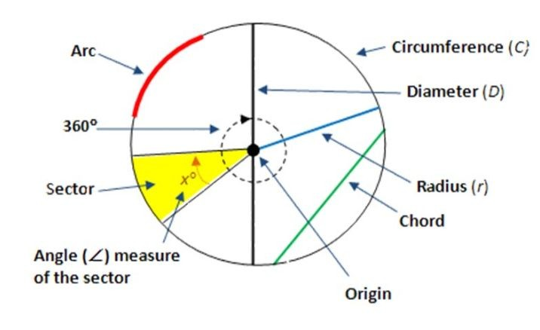
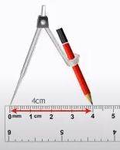
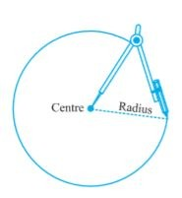
Circle
A circle is a shape where in all points have the same distance from the center .
Few real-world examples include a wheel, dining plate, coin etc.
Construction of circle When its radius is 4cm given.
Step 1 Open the compasses for the required radius of 4cm.
Step 2 Mark a point with a sharp pencil where we want the centre of the circle to be. Name it as O. Step 3 Place the pointer of the compasses on O. Step 4 Turn the compasses slowly to draw the circle. Be careful to complete the movement around in one instant.
For video Click Here

Slide 7
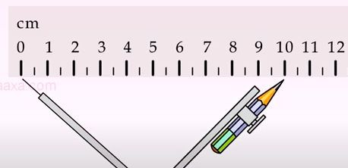
Line Segment
Line Segment The part of a line that connects two points. It is the shortest distance between the two points. It has a length. Line segment has two end point.
Construction of line segment of given length draw a line segment of length 10 cm.
Step 1 Draw a line l. Mark a point A on a line l.
Step 2 Place the compasses pointer on the zero mark of the ruler. Open it to place the pencil point up to the 10cm mark.
Step 3 Taking caution that the opening of the compasses has not changed, place the pointer on A and swing an arc to cut l at B.
Step 4 AB is a line segment of required length. For more Click here

Slide 8
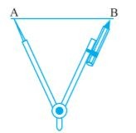
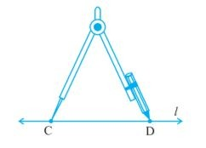
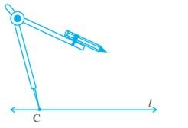
Construction a copy of a given line segment
To make a copy of AB.
Step 1 Given AB whose length is not known.
Step 2 Fix the compasses pointer on A and the pencil end on B. The opening of the instrument now gives the length of AB.
Step 3 Draw any line l. Choose a point C on l. Without changing the compasses setting, place the pointer on C.
Step 4 Swing an arc that cuts l at a point, say, D. Now CD is a copy of AB.
For more click here

Slide 9
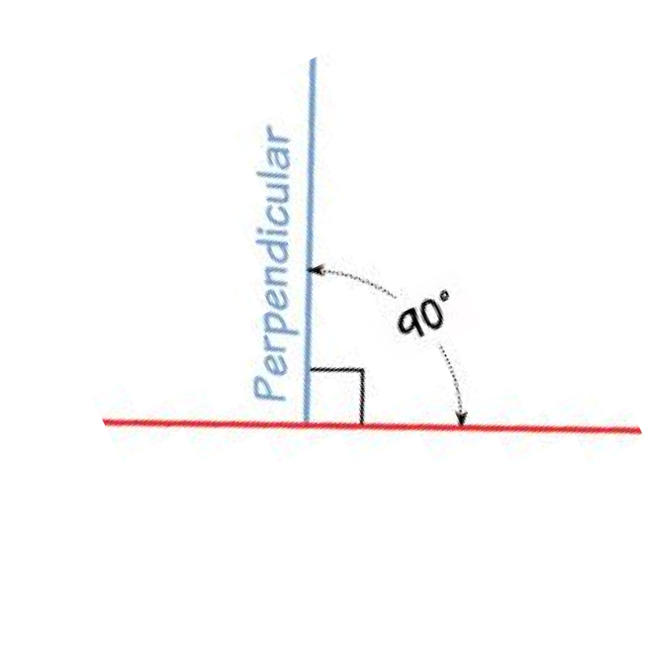
Perpendiculars
A line is said to be perpendicular to another line if the two lines intersect at a right angle.if figure both line intersect at 90 each other. So they are perpendicular to each other.

Slide 10
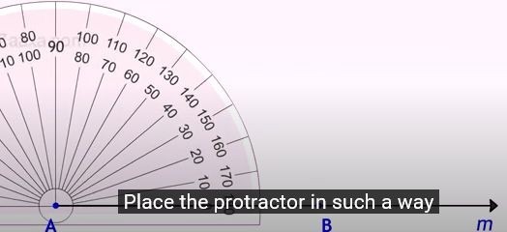
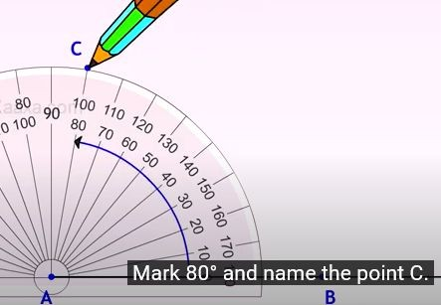
Constructing an angle of a given measure
Suppose we want an angle of measure 80°. Step 1 Draw AB of any length.
Step 2 Place the centre of the protractor at A and the zero edge along AB.
Step 3 Start with zero near B. Mark point C at 80°.
Step 4 Join AC. ∠BAC is the required angle.
For Video click here

Slide 11
Multiple choice Question
1. The instrument to measure an angle is a
(A) Ruler (B) Protractor (C) Divider (D) Compasses
2. The instrument to draw a circle is
Ruler (B) Protractor (C) Divider (D) Compasses
Number of set squares in the geometry box is (A) 0 (B) 1 (C) 2 (D) 3
The instrument in the geometry box having the shape of a triangle is called a
(A) Protractor
(B) Compasses
(C) Divider
(D) Set-square
5.Which of the following angles cannot be constructed using ruler and compasses? (A) 75° (B) 15° (C) 135° (D) 85°

